Slide 1
Data Capstone Project
USA CAR ACCIDENT SEVERITY PREDICTION

Slide 2
Introduction
Description & Disscusion of the Background
The economic and societal impact of traffic accidents cost U.S. citizens hundreds of billions of dollars every year. And a large part of losses is caused by a small number of serious accidents. Reducing traffic accidents, especially serious accidents, is nevertheless always an important challenge. The proactive approach, one of the two main approaches for dealing with traffic safety problems, focuses on preventing potential unsafe road conditions from occurring in the first place. For the effective implementation of this approach, accident prediction and severity prediciton are critical. If we can identify the patterns of how these serious accidents happen and the key factors, we might be able to implement well-informed actions and better allocate financial and human resources.

Slide 3
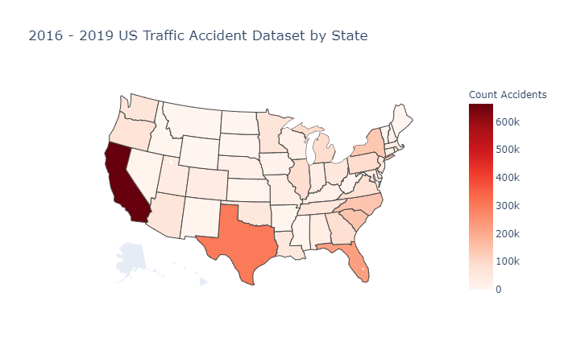
Accidents count (group by States)
As you can see the above image is the US traffic accident Dataset by State from 2016-2019.Where the dark red shaded region have the most number of accident cases.Which is California state.

Slide 4
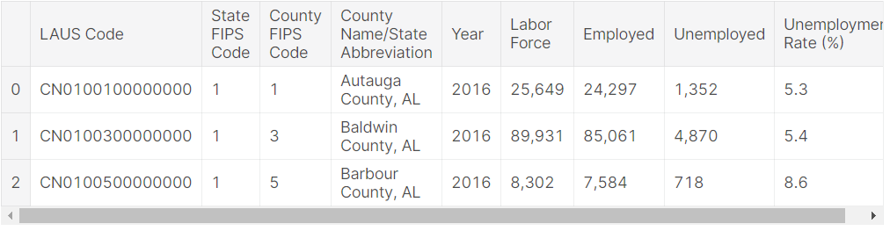
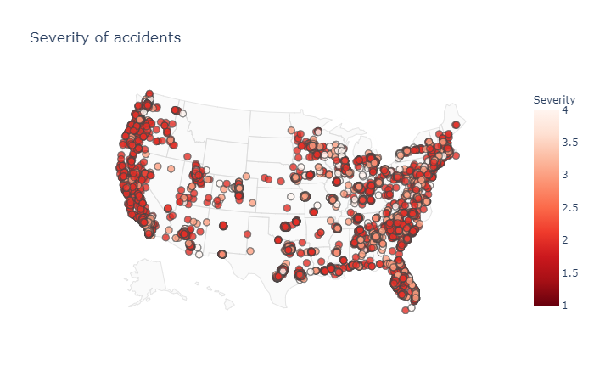
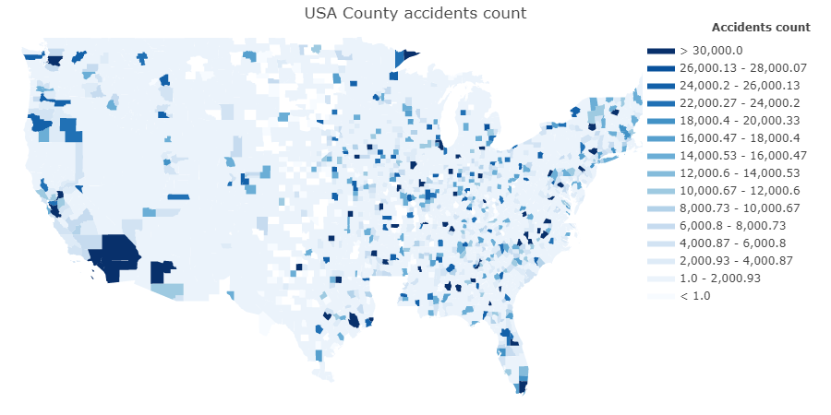
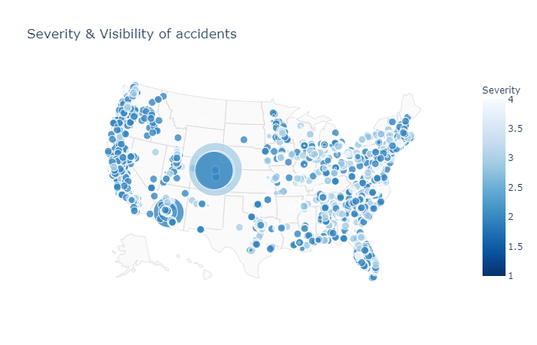
Now there is a county of accidents.In table formate.
Now the severity of Accidents.
Now in Geo plot of USA.
Distance and Severity

Slide 5
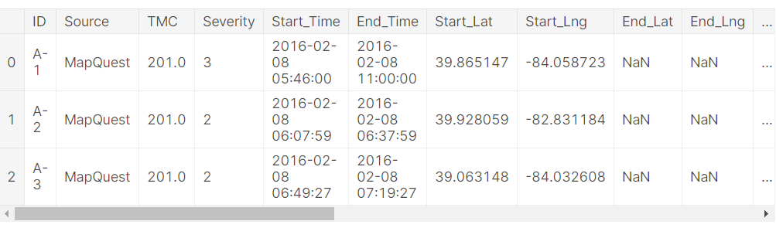
Data Description
US-Accident dataset is a countrywide car accident dataset, which covers 49 states of the United States. It contains 3 million cases of traffic accidents that took place from February 2016 to December 2019. In this project, however, only the data of accidents that happened after February 2019 and were reported by MapQuest was finally used in exploration analysis and modeling so that irrelevant factors can be eliminated to the greatest extent.
These data came from two sources, MapQuest and Bing, both of which report severity level but in a different way. Bing has 4 levels while MapQuest has 5. And according to dataset creator, there is no way to do a 1:1 mapping between them. Since severity is what we really care about in this project, I think it is crucial to figure out the difference.
B. Methodology
Country-wide accident severity can be accurately predicted with limited data attributes (location, time, weather, and POI).
Time series features are also very important, especially minute in a day. An accident is more likely to be a serious one when accidents happen less frequently at this time.
If an accident happens on Interstate Highway, there is a 2% chance that it will be a serious one, which is about 2.3 times of average and higher than any other street type.
An accident is much less likely to be severe if it happens near traffic signal while more likely if near junction.
Weather features like pressure, temperature, humidity, and wind speed are also very important.
Spatial patterns are the most useful features. For small areas like street and zipcode, severe accidents are more likely to happen at places having more accidents while for larger areas like city and airport region, at places having less accident.

Slide 6
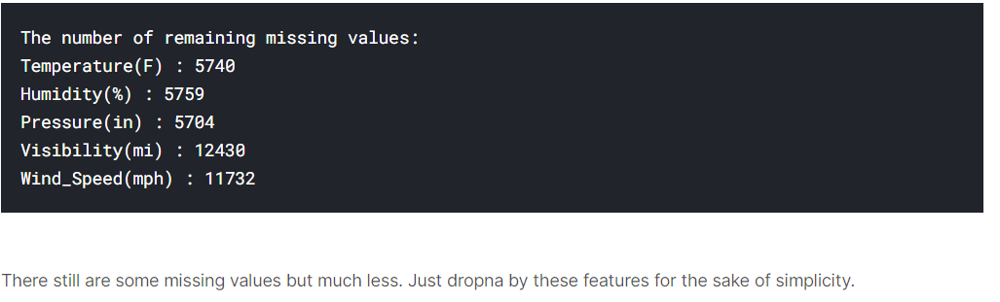
Value Imputation
Most of the rest columns only have small missing part that can be filled. (It is not absolutely necessary though, we can also just drop na)
Continuous Weather Data
Continuous weather features with missing values:
Temperature(F)
Humidity(%)
Pressure(in)
Visibility(mi)
Wind_Speed(mph)
Before imputation, weather features will be grouped by location and time first, to which weather is naturally related. 'Airport_Code' is selected as location feature because the sources of weather data are airport-based weather stations. Then the data will be grouped by 'Start_Month' rather than 'Start_Hour' because using the former is computationally cheaper and remains less missing values. Finally, missing values will be replaced by median value of each group.
Time Feature
Its gives the count of accidents by year.
There must be something wrong. It is impossible that the number of accidents with severity level 4 in 2019 is more than 5 times the number in 2018 while the number of other levels accidents is less. Let's back to raw data to have a look. I created a heatmap of accidents with severity level 4 from 2016 to 2019, seeing how they actually distributed.

Slide 7
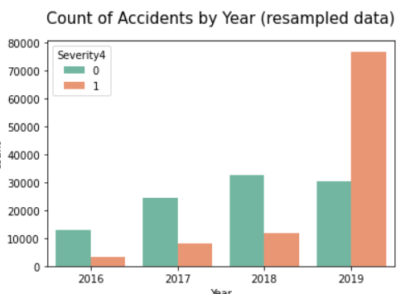
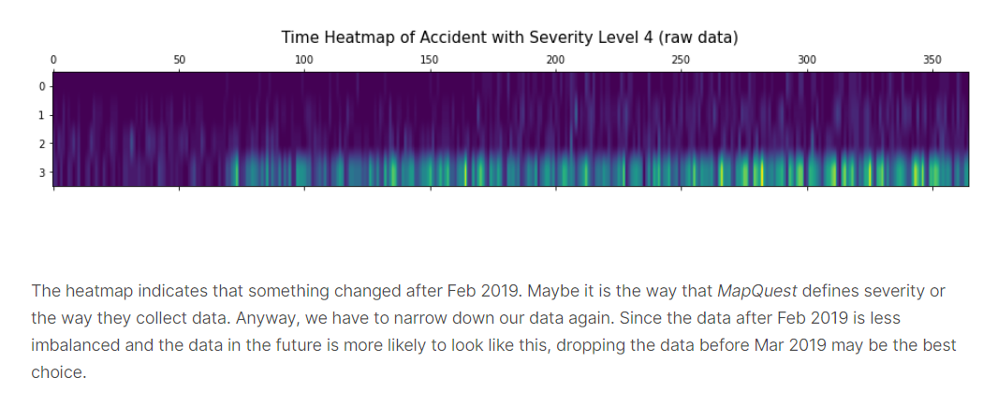
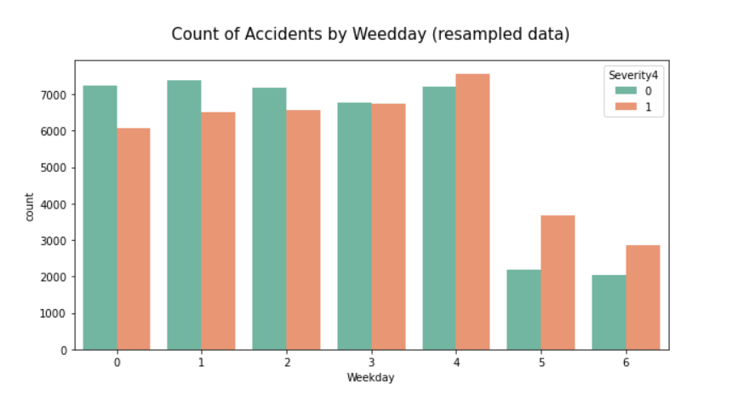
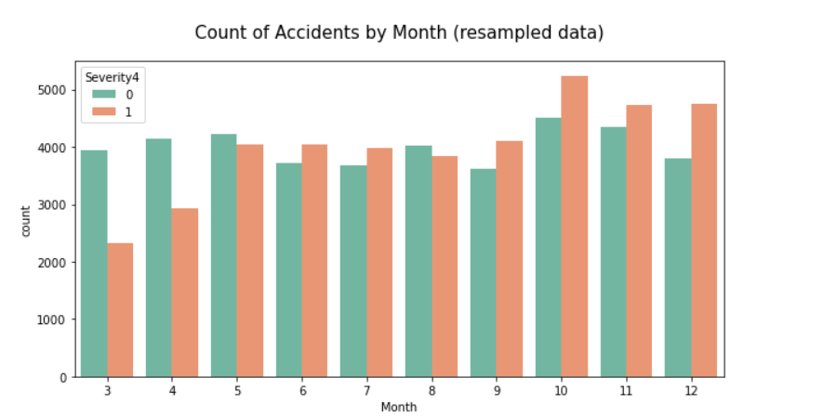
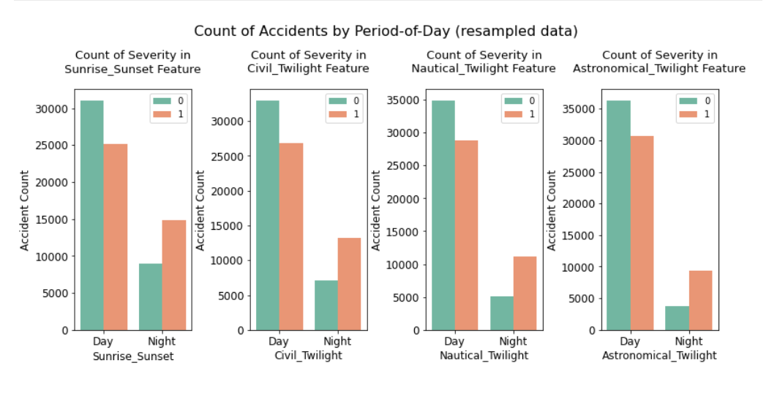
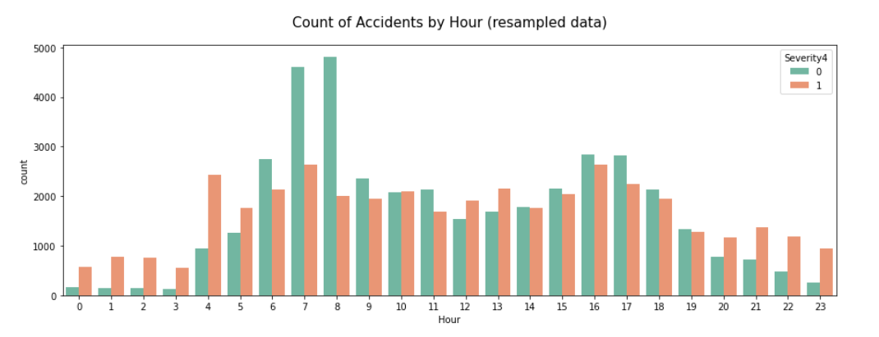
Month
It's quite interesting that the count of other levels accidents is mostly consistent from March to December, whereas the number of level 4 accidents rapidly increased from March to May and remained stable until September then increased again from October.

Slide 8
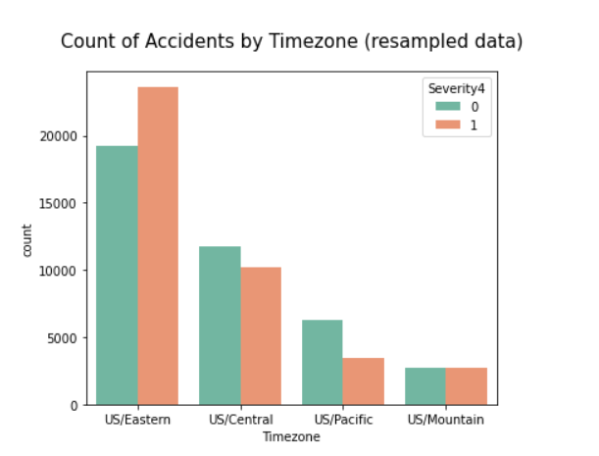
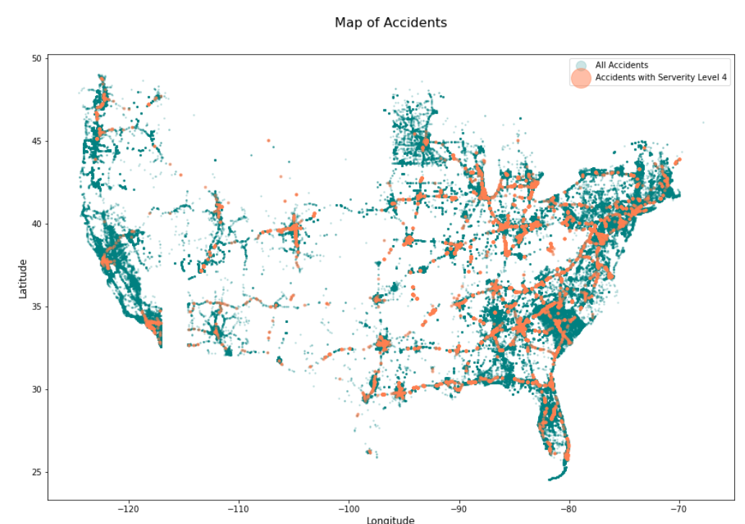
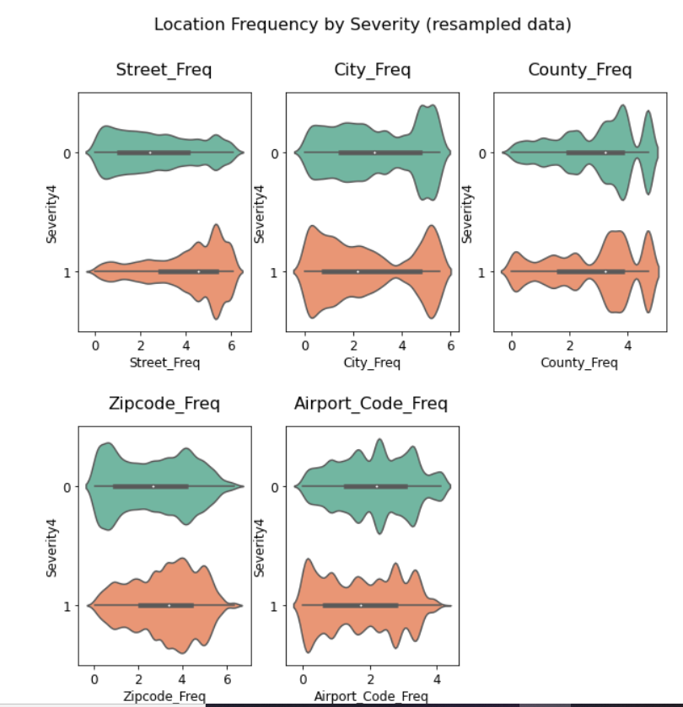
Map of Accidents
Now we will apply
Frequency Encoding
Similar to 'Minute', some location features like 'City' and 'Zipcode' that have too many unique values can be labeled by their frequency. Frequency encoding and log-transform:
'Street'
'City'
'County'
'Zipcode'
'Airport_Code'

Slide 9
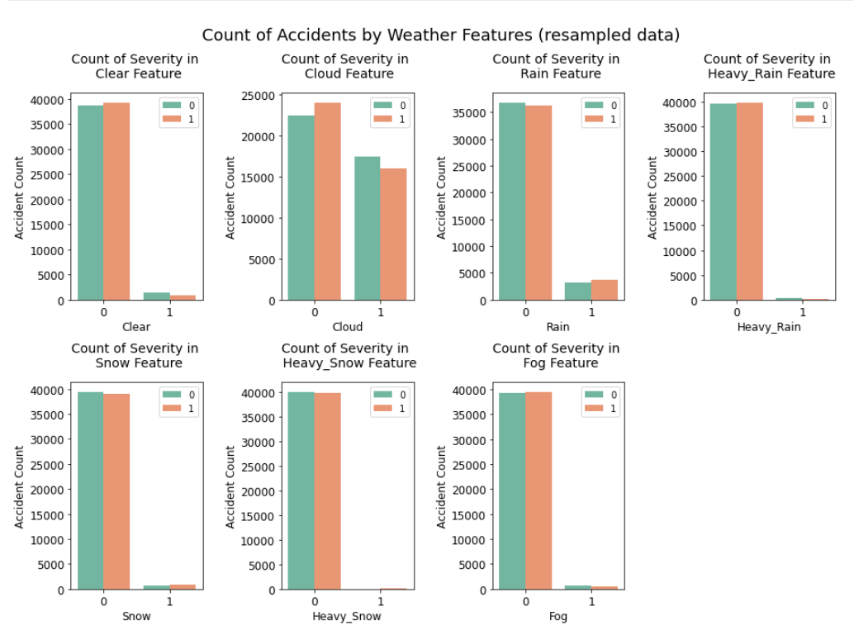

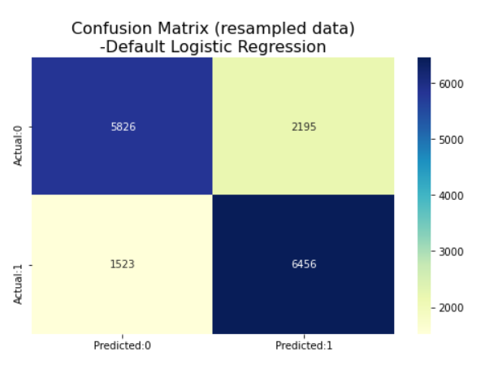
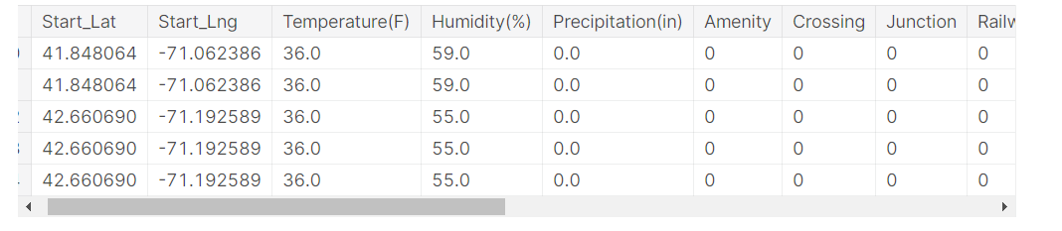
Logistic Regression
Logistic regression was emploied as a baseline to perform binary classification task.
Now we apply One-hot Encoding
One-hot encode categorical features.
As you can see we corrected all the column data for using ML and remove unwanted column also.

Slide 10
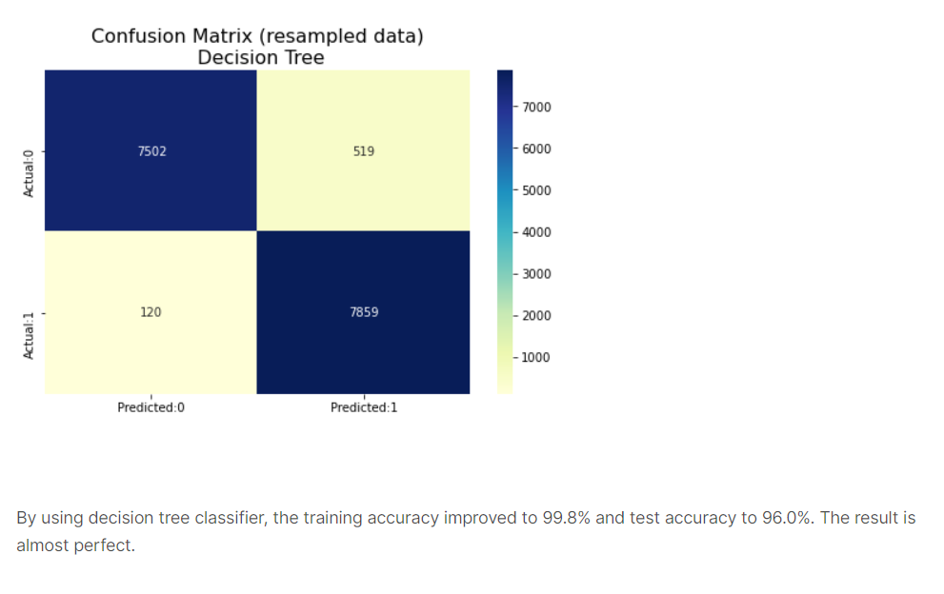
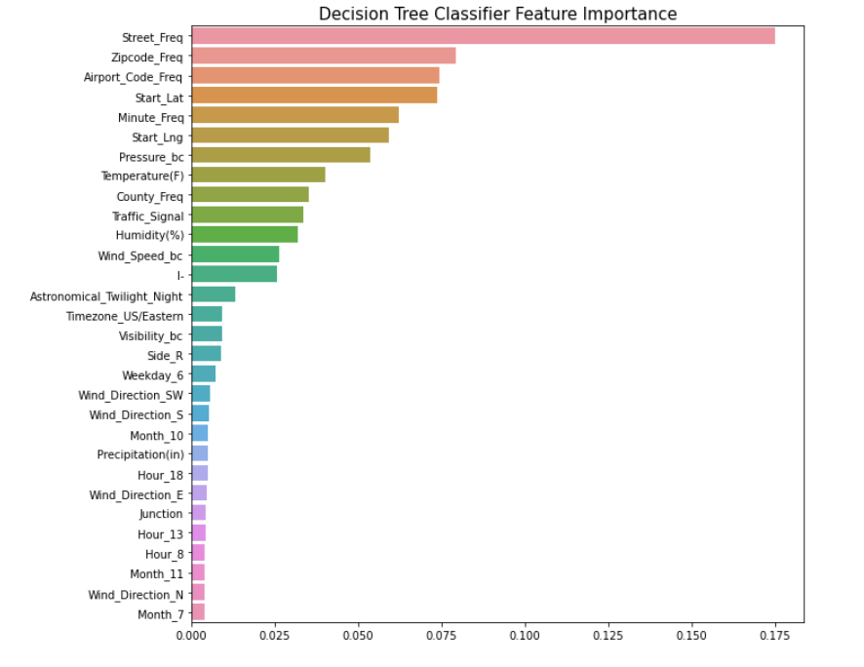
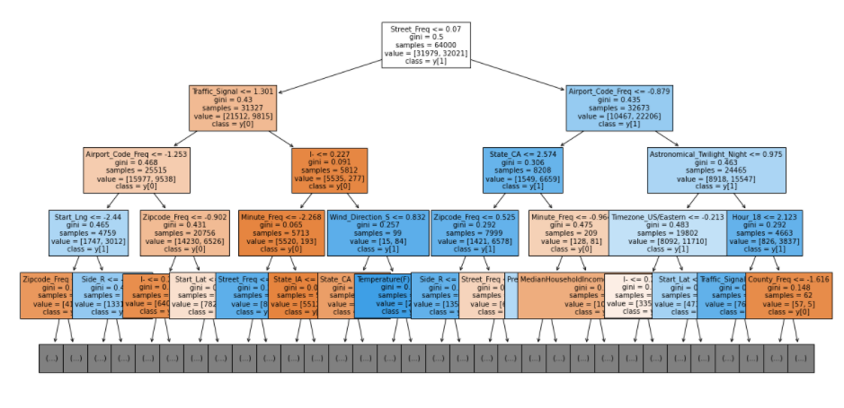
Decision Tree
Then, decision tree classifier was employied. The grid search was performed over choices of 'min_samples_split': {5,10, 20, 30, 40}, 'max_features': {None, 'log2', 'sqrt'}
The feature importance plot shows that high-resolution spatio-temporal patterns of accidents are the most useful features to predict severity. Among them, street frequency is far more important than any other feature. In addition to these spatio-temporal features, weather features like pressure, temperature, humidity, and wind speed are also very important. Some other features like interstate highway('I-'), traffic signal are important as well.

Slide 11
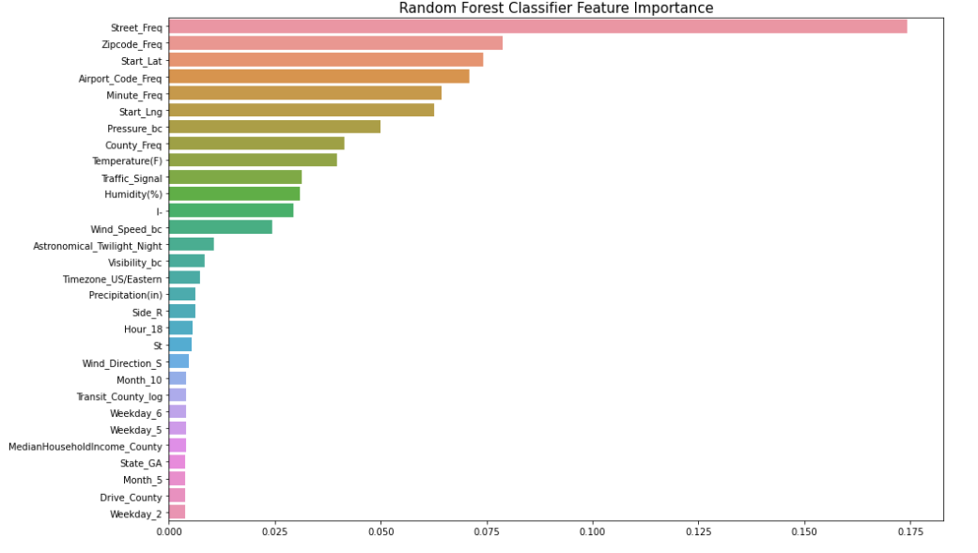
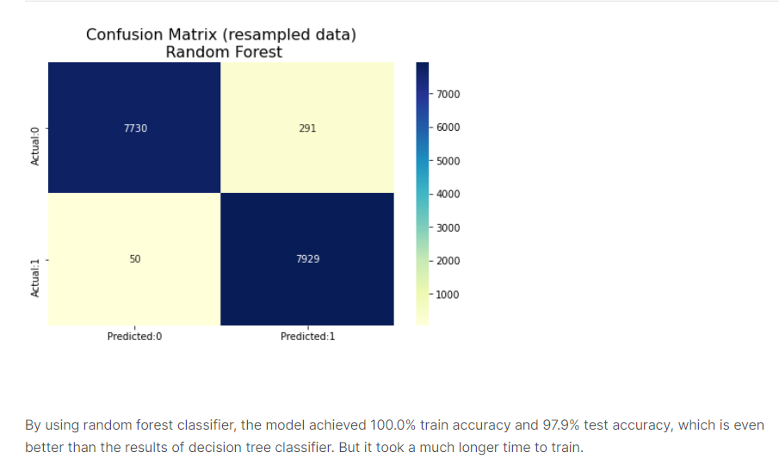
Random Forest¶
Finally, random forest classifier was employied. The grid search was performed over choices of 'n_estimators': {30,40,50}, 'max_depth': {20,30,40}
The top 15 important features of random forest model are almost as same as decision tree model.
D. Future Work¶
Incorporate this model in a real-time accident risk prediction model or develop a new real-time severe accident risk prediction on grid cells.
Detailed relations between some key factors and accident severity can be further studied.
Policy implications of this project can be explored.

